Slide 1
Agriculture Products Website
BY:
KUNAL BANDKAR 118IT1208A
REEYA BHADEKAR 119IT3257B
SHRADDHA BHAGAT 119IT3377B

Slide 2
TABLE OF CONTENT
Introduction
Existing System
Demerits
Proposed System
Merits
Technology Stack
Snapshot
Modules
Limitations
Conclusion
Future Scope

Slide 3
INTRODUCTION:
More than half of the Indian population depends on Agriculture, that's why we can say that Agriculture is a backbone of an Indian economy.
The contribution of Agriculture in the Indian economy is approx 22%, which is the highest contribution.
Being the most significant contributor in the Indian economy Indian farmers are not in a good state, and farming is facing ups & down due to unpredictable weather, water scarcity & less availability of the excellent quality of seeds.
As per the FICCI report, there is an ample opportunity to use modern technology in agriculture to solve many problems.
When we talk about modern technology than no one can ignore Ecommerce, eCommerce is changing the way of business; however, eCommerce is still not touched every sector in India.
Still, many E-commerce website for agriculture startups are trying to innovate & trying to implement eCommerce in agriculture, the main goal of the startups is to deliver the maximum benefits of the eCommerce, which will lead to saving resources.

Slide 4
EXISTING SYSTEM:
As per this case study looks up for lacking with many features depending upon the current technology development.
Not so vocal to all the users except the brands which were already featured with their own products.
The farmers were unable to get appropriate information about the products available. Absence of review sharing feature.
Not compatible, the whole process is not transparent

Slide 5
DEMERITS:
Lack of being vocal to our local brands.
Not so benefial for farmers as per selling aspect and profit point of view, due to lack of information obtained.
Lack of providing multiple features as per the current market situation as well as analysis.

Slide 6
PROPOSED SYSTEM:
The main objective of this project is to help farmers ensure greater profitability through direct farmer to end user communication.
Today E-commerce lacks fully automated business processes and still requires a significant manual effort by users.
Selling products through online channels enables farmers to bypass intermediaries, leading to improved income for the farmers, reduced wastage and fresher produce for customers.

Slide 7
MERITS:
The main objective of this project is to build a platform for farmers to sell their product and track the sale.
This platform is flexible which can maneuver the customer-farmer relationship in an effective manner.
Farmer will get unique interface where they can avail everything right
from learning to the market information.
This website will act as unique and secure way to perform agro-marketing.

Slide 8
TECHNOLOGY STACK
HTML (Hyper Text Markup Language)
CSS (Cascading Style Sheets)
JAVASCRIPT
PHP
MySQL ( Database Server)

Slide 9
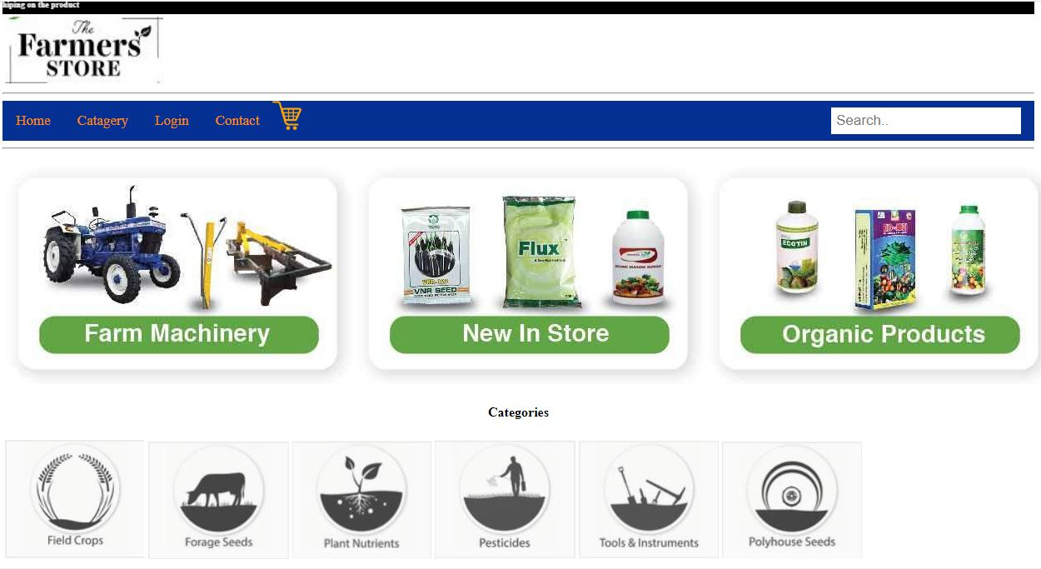
HOMEPAGE

Slide 10
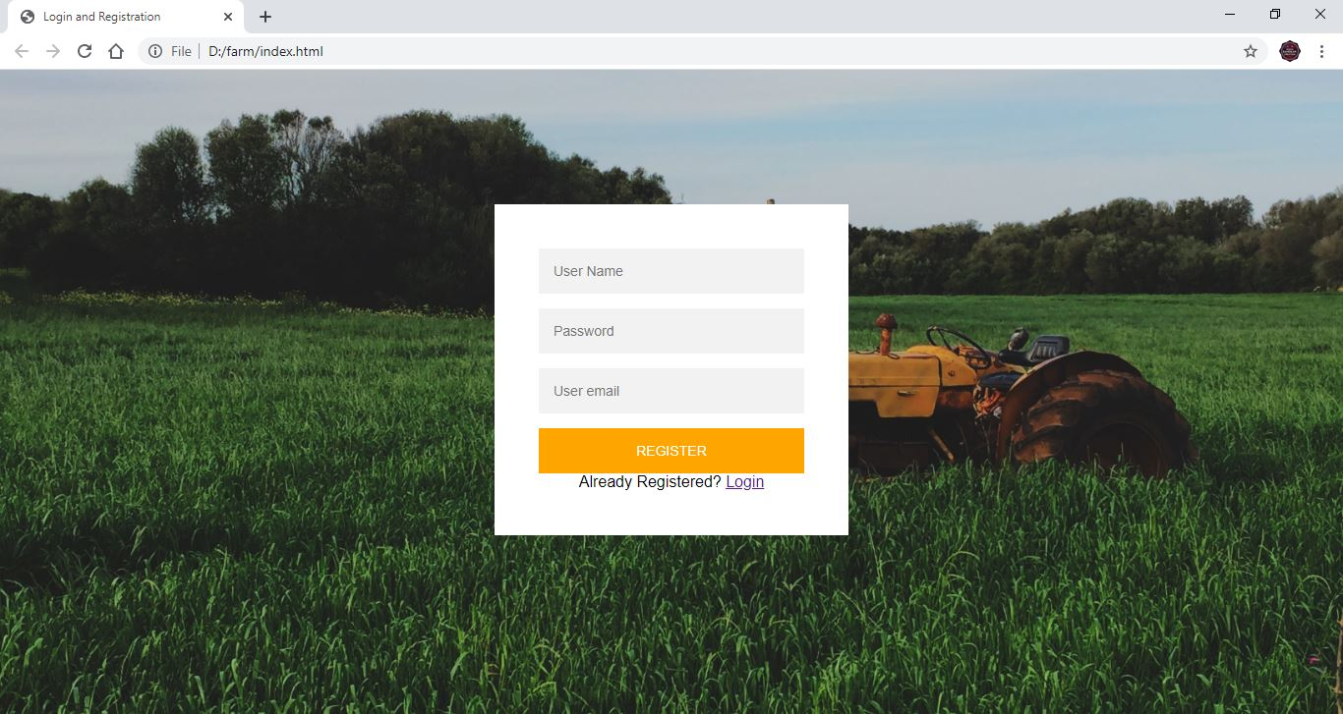
REGISTRATION PAGE

Slide 11
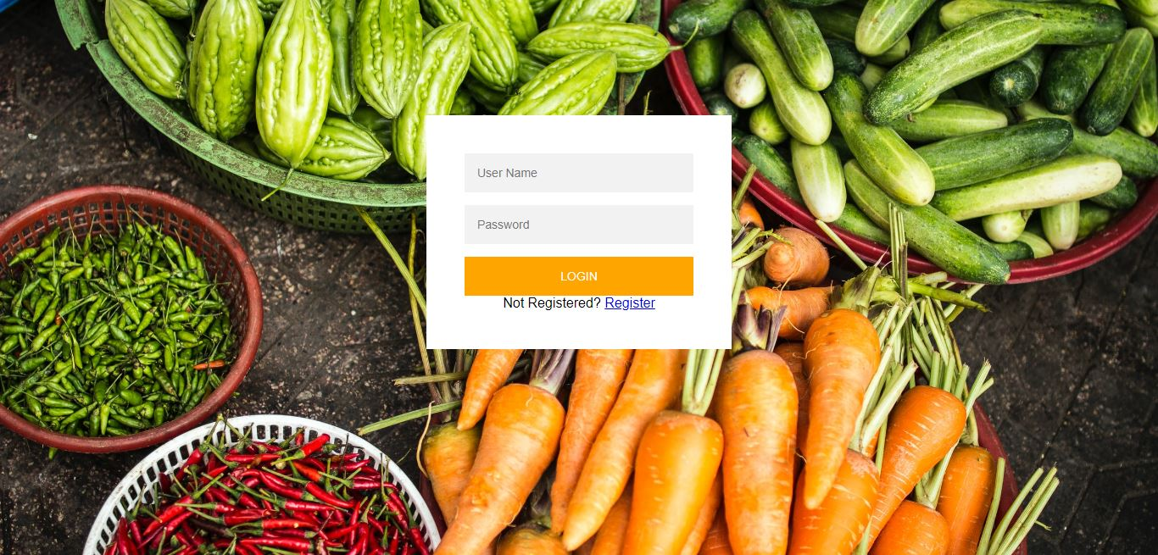
SNAPSHOT: LOGIN PAGE:

Slide 12
MODULES
Registration Page: A new user can register, by providing required data and can save them for future use.
User Account: After login, the user is able to browse through various features
Home Page: Providing a glimpse of all the features and category which are available for users.
Category: Providing a ease of access to the users to shop as per their requirements, by dividing the selling items as per their category.
Add to Cart: Customer can product to cart even they are not registered but they cannot
Pay the bill. Only a registered customer can avail the payment option.
Payment: The customer can buy the product from website and pay online or cash.

Slide 13
LIMITATIONS:
Language Barrier
Indian is a country of many languages & providing the same kind of a facility in different styles is a little tricky.
Internet Connectivity
Many people still can use the internet; unavailability of the internet makes e-commerce website for agriculture is less beneficial.
Lack of Talents
Agriculture is also facing the right kind of talent the same as technology, so e-commerce website is also facing the shortage of abilities who really can make the effect towards the betterment of the Agriculture sector.
Electricity Issue
E-commerce website for agriculture is not up to the mark without enough availability of the electricity; information can't send effectively.

Slide 14
CONCLUSION:
Ecommerce website in agriculture is in a very initial stage how much benefit it will make on the agriculture sector is very early to predicts.
Still, it may help many people in this sector to understand this very competitive & complex sector.

Slide 15
FUTURE SCOPE:
By using various on-line facilities on website , E-Commerce has led to innovations on delivery time, ease of transactions and features like speed delivery or artificial intelligence.
We can develop the site more dynamically. In future can add the few modules for better improvement of the project such as, real-time chat bot option for user and farmer, so that user can directly enquiry theirs problem on any time through the chat bot.

